Slide 1
Topic
Explain Collection interface and its basic methods,
Explain List Interface and its basic methods

Slide 2
Collection Interface
Collection framework is a class library used to handle group of objects.
Collection framework is implemented in java.util package.
A collection object doesn’t stores the physical copies of other objects but it stores the references of other objects.
If we want to represent a group of individual objects as a single entity then we should go for collection.

Slide 3
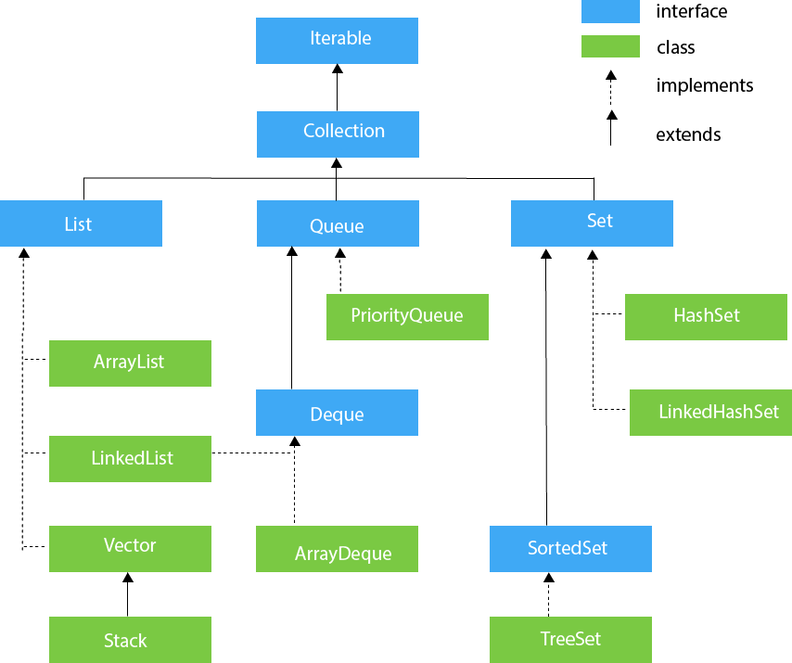
Collection Interface and Its Sub Interface(Hierarchy)

Slide 4
Methods Of Collection Interface
Boolean addAll(Collection<? extends E> c) - Adds all of the elements in the specified collection to this collection (optional operation).
void clear() - Removes all of the elements from this collection (optional operation).
boolean contains(Object o) - Returns true if this collection contains the specified element.
Boolean containsAll(Collection<?> c) - Returns true if this collection contains all of the elements in the specified collection.
Boolean equals(Object o) - Compares the specified object with this collection for equality.
Int hashCode() - Returns the hash code value for this collection.

Slide 5
Boolean isEmpty() - Returns true if this collection contains no elements.
Iterator<E> iterator() - Returns an iterator over the elements in this collection.
default Stream<E> parallelStream() - Returns a possibly parallel Stream with this collection as its source.
Boolean remove(Object o) - Removes a single instance of the specified element from this collection, if it is present (optional operation).
Boolean removeAll(Collection<?> c) - Removes all of this collection's elements that are also contained in the specified collection (optional operation).
default Boolean removeIf(Predicate<? super E> filter) - Removes all of the elements of this collection that satisfy the given predicate.
Boolean retainAll(Collection<?> c) - Retains only the elements in this collection that are contained in the specified collection (optional operation).
Int size() - Returns the number of elements in this collection.
default Spliterator<E> spliterator() - Creates a Spliterator over the elements in this collection.
default Stream<E> stream() - Returns a sequential Stream with this collection as its source.
Object[] toArray() - Returns an array containing all of the elements in this collection.
<T> T[] toArray(T[] a) - Returns an array containing all of the elements in this collection; the runtime type of the returned array is that of the specified array.

Slide 6
List Interface
List Interface is one of the child interface of collection interface.
It is used to represent group of objects as a single object.
Available in java.util package
List in Java provides the facility to maintain the ordered collection.
It contains the index-based methods to insert, update, delete and search the elements.
It can have the duplicate elements also.
We can also store the null elements in the list.
Through the ListIterator, we can iterate the list in forward and backward directions.
Index is very important in list.
Insertion order is preserved via index.
We can differentiate duplicate objects through index.
Operations available are – Insert, Update, Delete, Positional access, Search, Iteration, Range view.

Slide 7
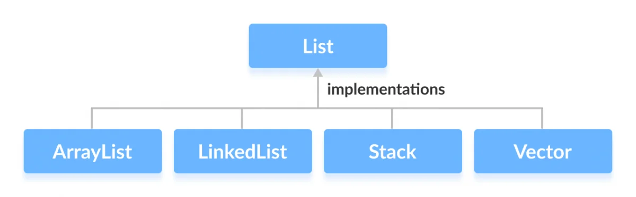
Classes In List

Slide 8
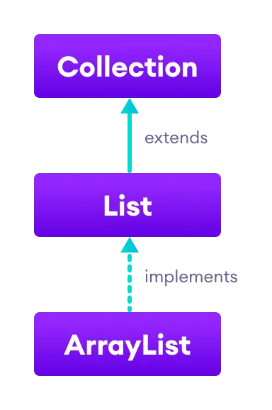
ArrayList -
The ArrayList class of the Java collections framework provides the functionality of resizable-arrays.

Slide 9
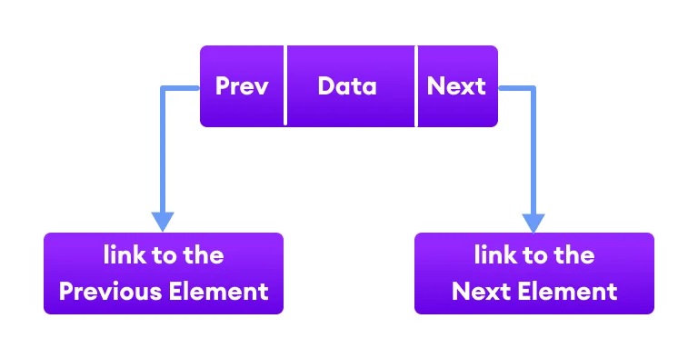
LinkedList
The LinkedList class of the Java collections framework provides the functionality of the linked list data structure (doubly linkedlist).

Slide 10
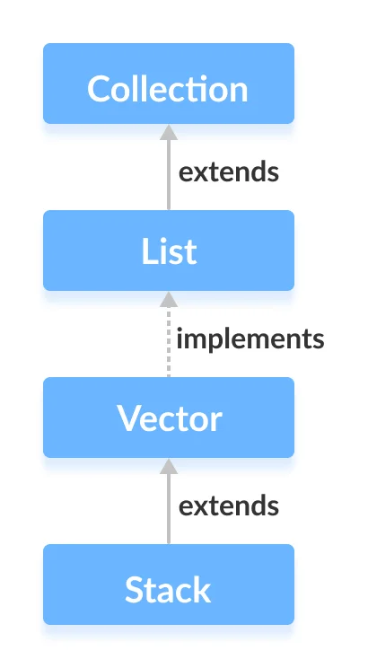
Stack
In stack, elements are stored and accessed in Last In First Out manner.

Slide 11
Vector
The Vector class is an implementation of the List interface that allows us to create resizable-arrays similar to the ArrayList class.

Slide 12
Basic Method Of List Interface
void add(int index, Object o) - adds an element
Boolean addAll(int index, Collection) – adds a group of elements
object get(int index) – returns object at index
object remove(int index)- removes the object at the index
Object removeAll()- removes all the element form the list
clear()- removes all the element from the list(more efficient than removeAll)
Size()- returns the length of list
object set(int index, object new) – replaces old object with new object at the specified index
int indexOf(Object obj)- returns index of first occurrence of obj
toArray() – converts a list into array
contains()- returns true if a list contains specified value

Slide 13
Methods continued….
sort — sorts a List using a merge sort algorithm, which provides a fast, stable sort.
(A stable sort is one that does not reorder equal elements.)
shuffle — randomly permutes the elements in a List.
reverse — reverses the order of the elements in a List.
rotate — rotates all the elements in a List by a specified distance.
swap — swaps the elements at specified positions in a List.
replaceAll — replaces all occurrences of one specified value with another.
fill — overwrites every element in a List with the specified value.
copy — copies the source List into the destination List.
binarySearch — searches for an element in an ordered List using the binary search algorithm.
indexOfSubList — returns the index of the first sublist of one List that is equal to another.
lastIndexOfSubList — returns the index of the last sublist of one List that is equal to another.

Slide 14
Thank You

